Slide 1
Ivano-Frankivsk Regional State (Military) Administration

Slide 2
Best practices in child protection for children left behind whose parents work abroad

Slide 3
Legal framework
The Convention on Jurisdiction, Applicable Law, Recognition, Enforcement and Co-operation in respect of Parental Responsibility and Measures for the Protection of Children of October 19, 1996
The Constitution of Ukraine
The Civil Code of Ukraine
The Family Code of Ukraine
The Law of Ukraine "On Protection of Childhood“
Resolution of the Cabinet of Ministers of Ukraine of January 27, 1995, No. 57 "On Approval of the Rules for Crossing the State Border by Citizens of Ukraine"
Order of the Ministry of Science and Education of Ukraine of December 28, 2006, No. 865 "On social, pedagogical and psychological work with children of migrant workers"

Slide 4
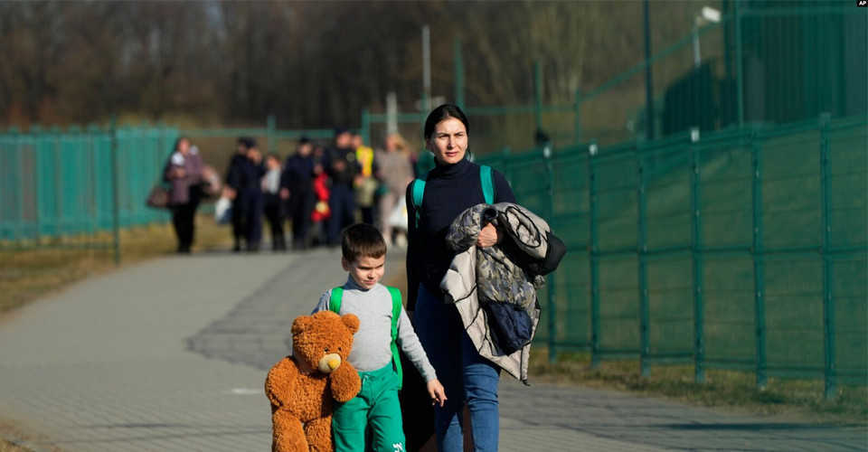
Since the beginning of the war, 1.8 million children have left Ukraine, including more than 10,000 vulnerable children and 196 24-hour care facilities (educational, healthcare, social protection and private institutions).

Slide 5
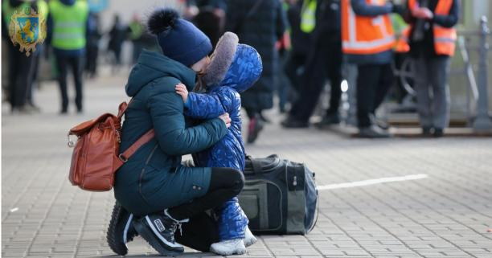
Challenges in the field of child protection for children leftbehind whose parents work abroad
proper regulation at the legislative level
creation of an effective system of assistance to children whose parents are abroad (restoration of the child's psycho-emotional state, socialization of the child)
conducting advanced training and retraining of personnel (social work specialists, social educators, psychologists, teachers)

Slide 6
Thank you for your attention!
Vă mulțumim pentru atenție!

